Slide 1




Slide 2

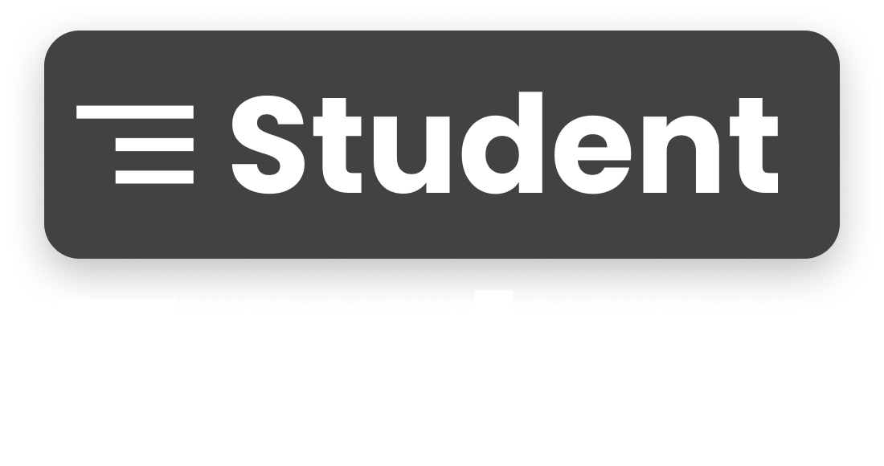

Slide 3
CHALLENGES
→ Time Management: Juggling classes, studying, assignments, and other commitments often leads to difficulties in managing time effectively.
→ Procrastination: Putting off tasks until the last minute can create stress and hinder academic performance.
→ Errands and Chores: Completing everyday tasks like grocery shopping, laundry, or cleaning can take valuable time away from studies.

Slide 4
OUTCOME
→ Increased student productivity: By providing a platform to delegate tasks in various categories , students can free up time for studying, extracurricular activities, or personal well-being.
→ Improved time management: Categorizing tasks and adding specific details helps students stay organized and prioritize their responsibilities efficiently.
→ Reduced stress and anxiety: Distributing tasks and receiving help can alleviate the pressure and workload often faced by students.

Slide 5
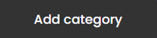
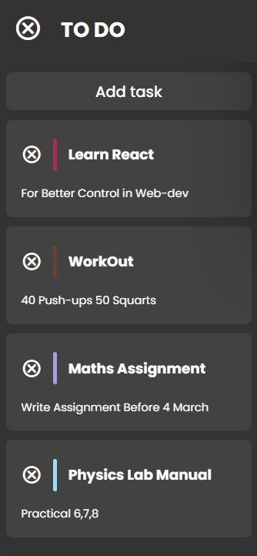
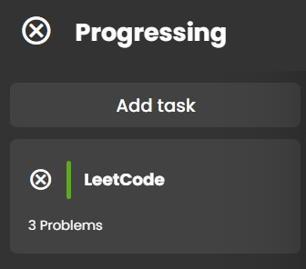
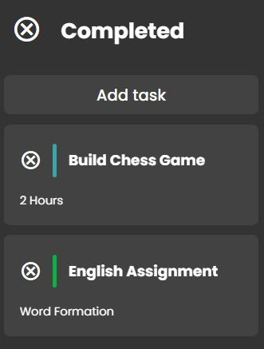
OUR INNOVATION
Add Task
Description

Slide 6

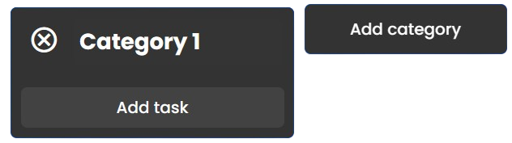
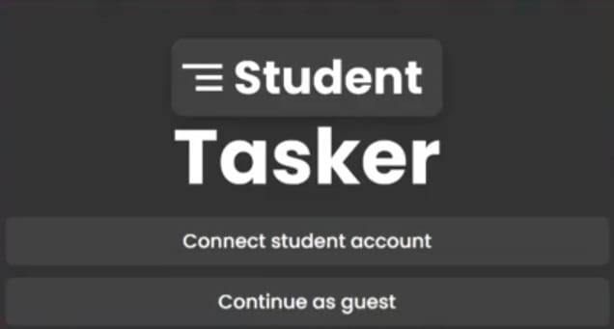

WORK - FLOW
Use student tasker
Connect student tasker
Add category
and task

Slide 7
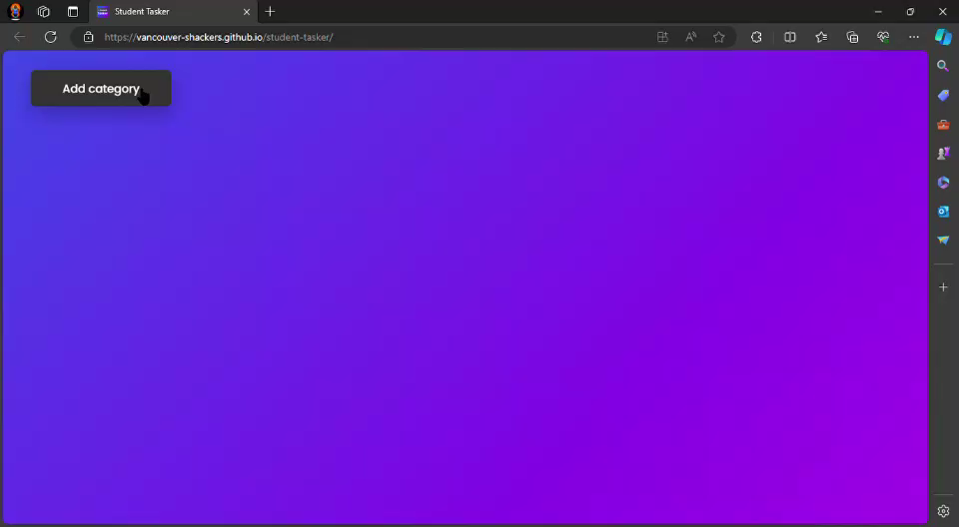
ADDITION & DELETION OF TASK & CATEGORY

Slide 8
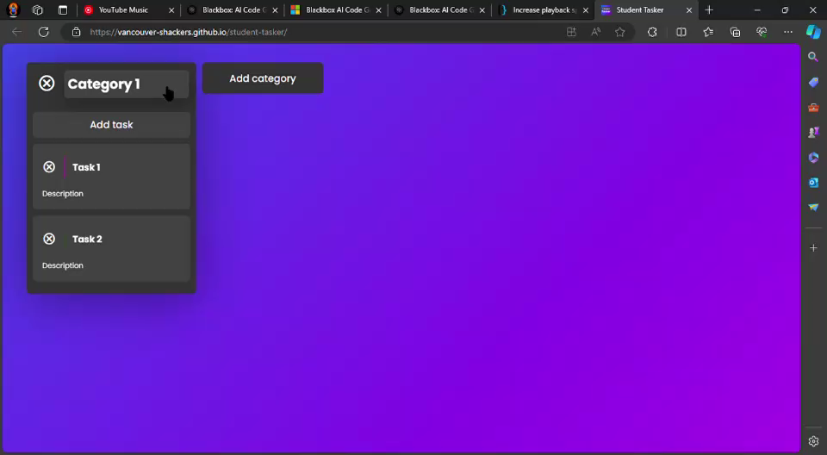
EDITABLE TASK , CATEGORY & DESCRIPTION

Slide 9
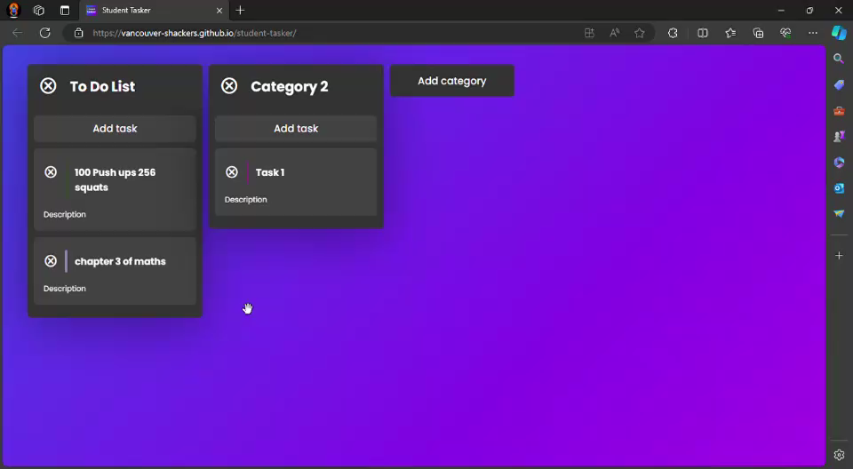
DRAG & DROP FUNCTIONALITY
THANK YOU…

Slide 10
Thank you

